Slide 1
Comparing Community Demographics to Fast Food Appetites
Coursera Data Science Capstone Project Richard Queen December 21, 2019

Slide 2
Introduction
BMI has become a major health issue in the United States
Associated with exponentially higher mortality rates
Creates higher risk for multiple chronic disease conditions like heart failure and diabetes
From 1990 to 2017, BMI rose almost 176% in the US, with more than 30% of adults now being obese
Fast Food meal portions are 4 times larger than they were in 1950s
This study will look at correlation between Fast Food choices of a community and that community’s socioeconomic demographic

Slide 3
Data method
Data Collection
Feature Selection
Preprocessing
Model Fit
Clustering
Inspection
We will be utilizing this data flow pipeline to pull in our data, understand it, preprocess and standardize it, cluster, and then analyze the results. I will explain each step of the process as we move through this pipeline with our data.

Slide 4
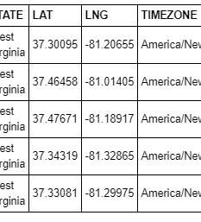
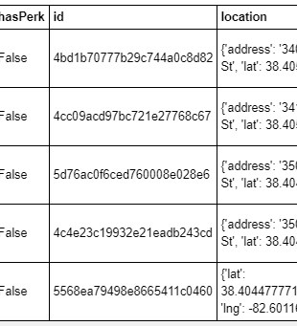
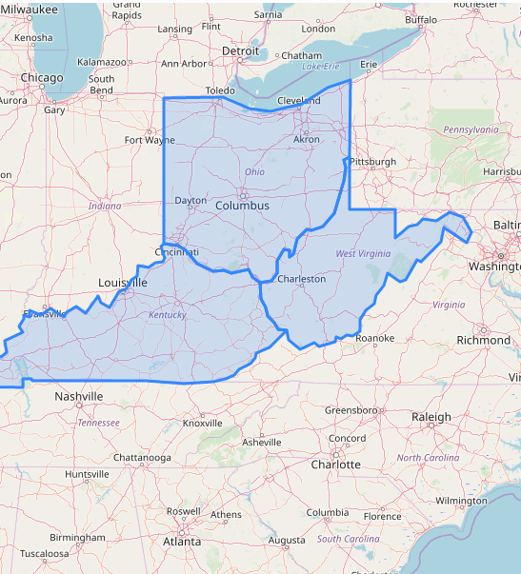
Data collection sources
US census demographics by zip code
Foursquare api “top pick” venues
Geojson map layout files

Slide 5
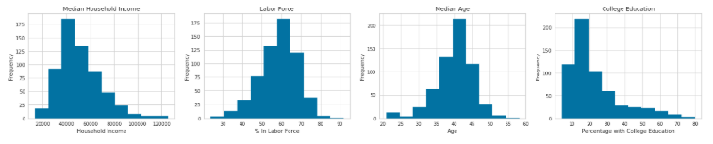
Feature selection
We first select features to cluster zip code communities on socioeconomic status
We focus on key metrics of median household income, percentage in labor force, median age, and education level

Slide 6
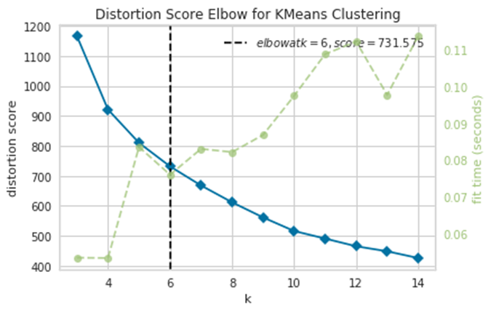
Elbow method
The elbow method measures the distortion score at various values of K in K Means clustering. Our analysis tells us that 6 is the optimal level of K. This means we will cluster our community zip codes into 6 distinct groups or clusters.

Slide 7
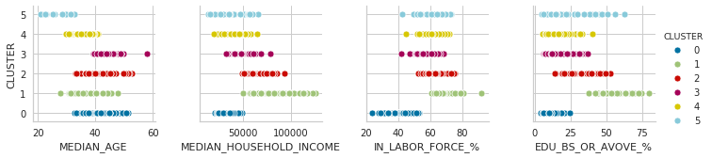
Cluster characteristics
Cluster 3: Older, Employed, Lower Educated, Middle Income
Cluster 0: Middle Aged, Unemployed, Uneducated, Low Income
Cluster 2: Middle Aged, Employed, Educated, Higher Income
Cluster 4: Younger, Employed, Lower Educated, Low Income
Cluster 1: Middle Aged, Highly Employed, Highly Educated, High Income
Cluster 5: Young, Employed, Lower Educated, Low Income

Slide 8
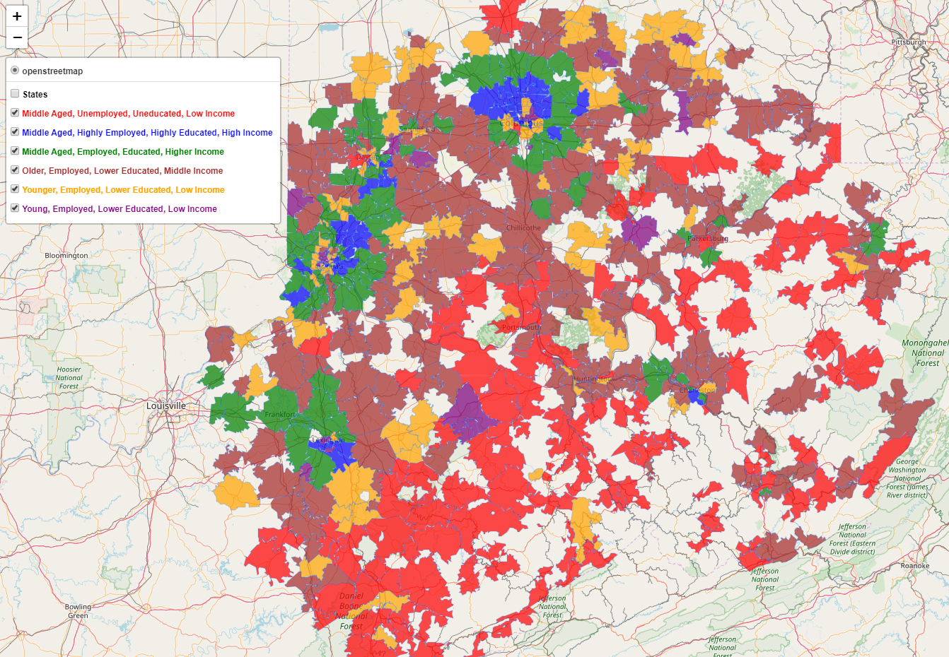

Slide 9
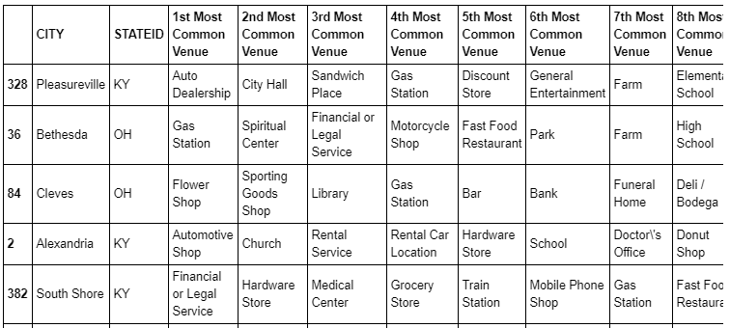
Foursquare top venues per city
We are able to pull top 10 venues per city in order to cluster our communities a second way and then look for correlation

Slide 10
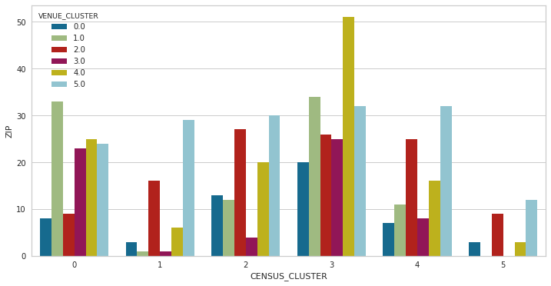
results
Unfortunately, in this data pull from the Foursquare API, we do not see a high level of correlation between our demographic clustering and our top venue clustering.

Slide 11
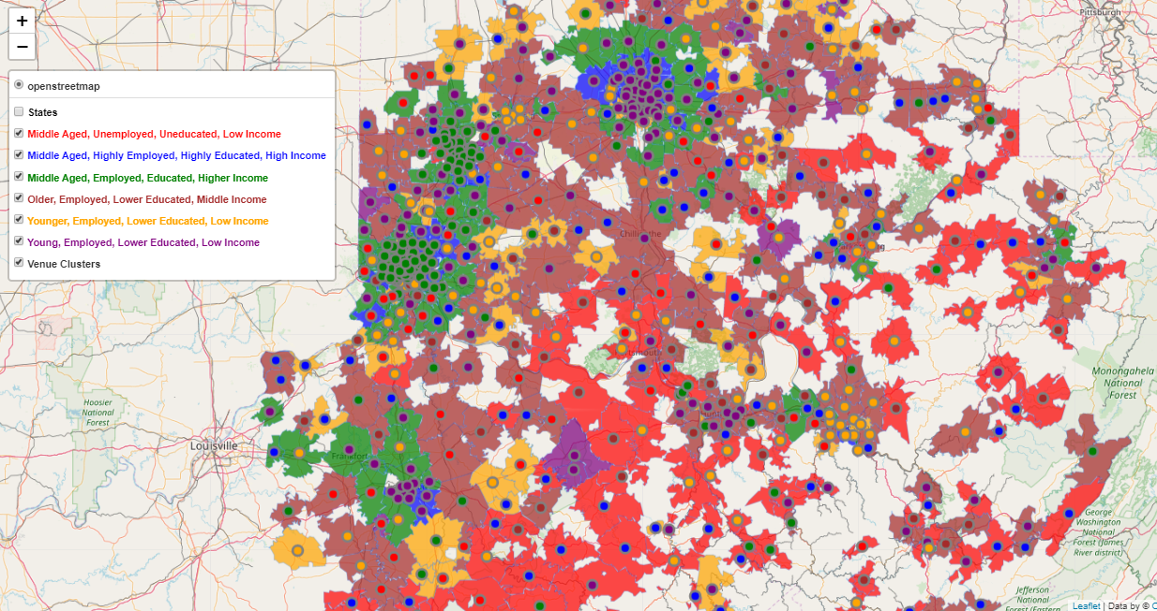

Slide 12
Conclusion & Next steps
Inconclusive results in showing correlation between socioeconomic clustering and top venue choice clustering
May be able to show better results by reducing the feature count on the venue clustering
May also restrict the venues to food type only and look for type of food or number of food venues by zip
This iterative process is the life of a data scientist, being able to think through and then utilize the tools necessary for the next iteration

Slide 13
references
ProCon: US Obesity Levels by State
FourSquare API
Census.gov API
OpenDataDE Zip Code Level GeoJSON

